Slide 1
The Linux Command Line Chapter 1
What is the Shell?
Prepared by Dr. Reyes, New York City College of Technology

Slide 2
What is the Shell?
Shell - a program that takes keyboard commands and passes them to the operating system to carry out
Types of Shells:
C-Shell: csh, tcsh
Bourne Shell: sh
Bourne Again Shell: bash
When using a GUI, a terminal emulator is used to interact with the shell
KDE uses konsole
GNOME uses gnome-terminal

Slide 3
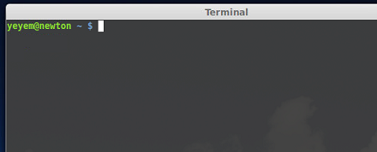
Shell Prompt

Slide 4
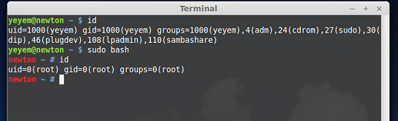
Session Privileges
Prompt ending with:
$ - regular user, privileges varies
# - superuser

Slide 5

Some Simple Commands
Try the date command:
Displays the current date

Slide 6
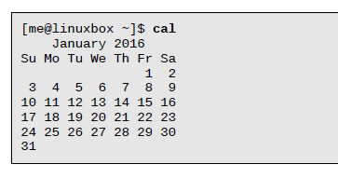
Some Simple Commands
Try the cal command:
Displays the calendar

Slide 7
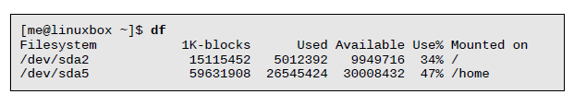
Some Simple Commands
Try the df command:
Displays the disk available

Slide 8
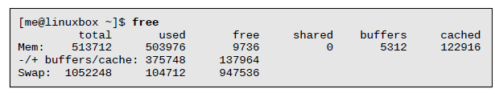
Some Simple Commands
Try the free command:
Displays the memory available

Slide 9

Some Simple Commands
Try the exit command:
Use it to exit the system

Slide 10
Command History
Press up-arrow key for previous command
Press down-arrow key for next command
Press left-arrow key to move back in the same line
Press right-arrow key to move back in the same line
Limited support for mouse interaction
Some keyboard shortcuts might not work, as they belong to Windows:
Ctrl-C
Ctrl-V

